Slide 1
IST-687 Final Project
Project Owners (Individual):
Sharat Sripada

Slide 2
Overall Summary – Update#3
Accomplishments this last period
Used ggplot to visualize analysis from Update #2
Ran linear regression (correlation analysis) on the following variables from Update #2:
Delay & Popularity of airline - WEAK
Satisfaction & Popularity of airline - WEAK
Loyalty cards & Popularity of airline - STRONG
Delay & Satisfaction – MEDIUM
All analysis between Delay, Satisfaction, Loyalty cards yielded low R-square values.
What is working well
Code implementation – modular design and using concepts/learnings from the course
Setup review with peer for final project
Plans for next update
Re-visit project rubric and prep for final presentation
Make suggestions to improve passenger affinity to an airline – mostly in terms in loyalty cards/discounts offered to passengers
Explore all regression/classification models from HW8/HW9 to predict outcomes based on actions
Issues/What is not working well
No blocking issues
Setup office-hours with Prof. Krudys to review progress & seek guidance

Slide 3
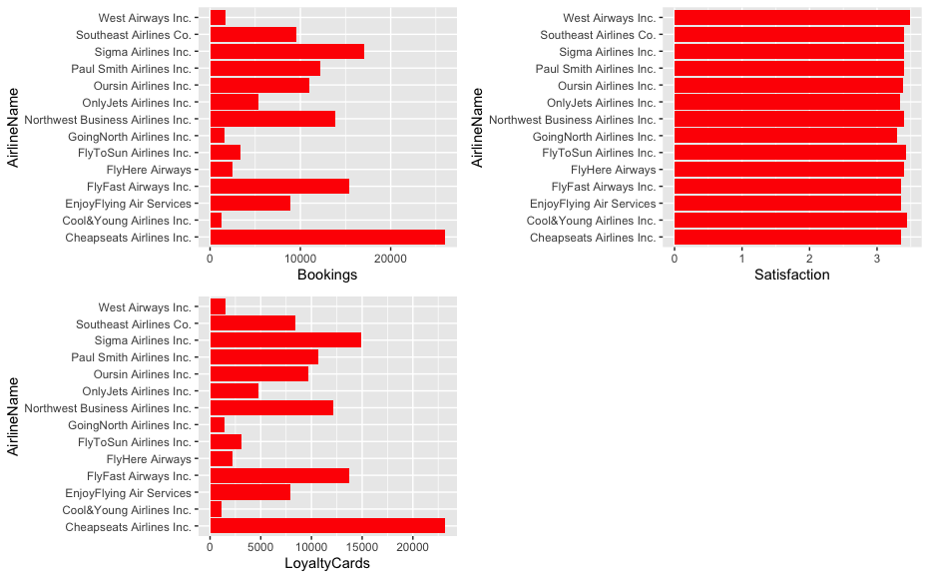
ggplot – popularity, satisfaction, loyalty program – Update#3

Slide 4
Conclusion – Update#3
Very low co-relation between variables – ran the step function to determine the lowest number of variables that can accurately predict an independent variable/Parsimonious model (with formula = Satisfaction ~. <all-numeric-comparible-vars>) which yielded very low correlation results
To spend more time analyzing & comparing the following models to make predictions:
Linear regression/lm()
Kernel Support Vector Machines/ksvm()
Support Vector Machines/svm()
Naïve Bayes

